Slide 1
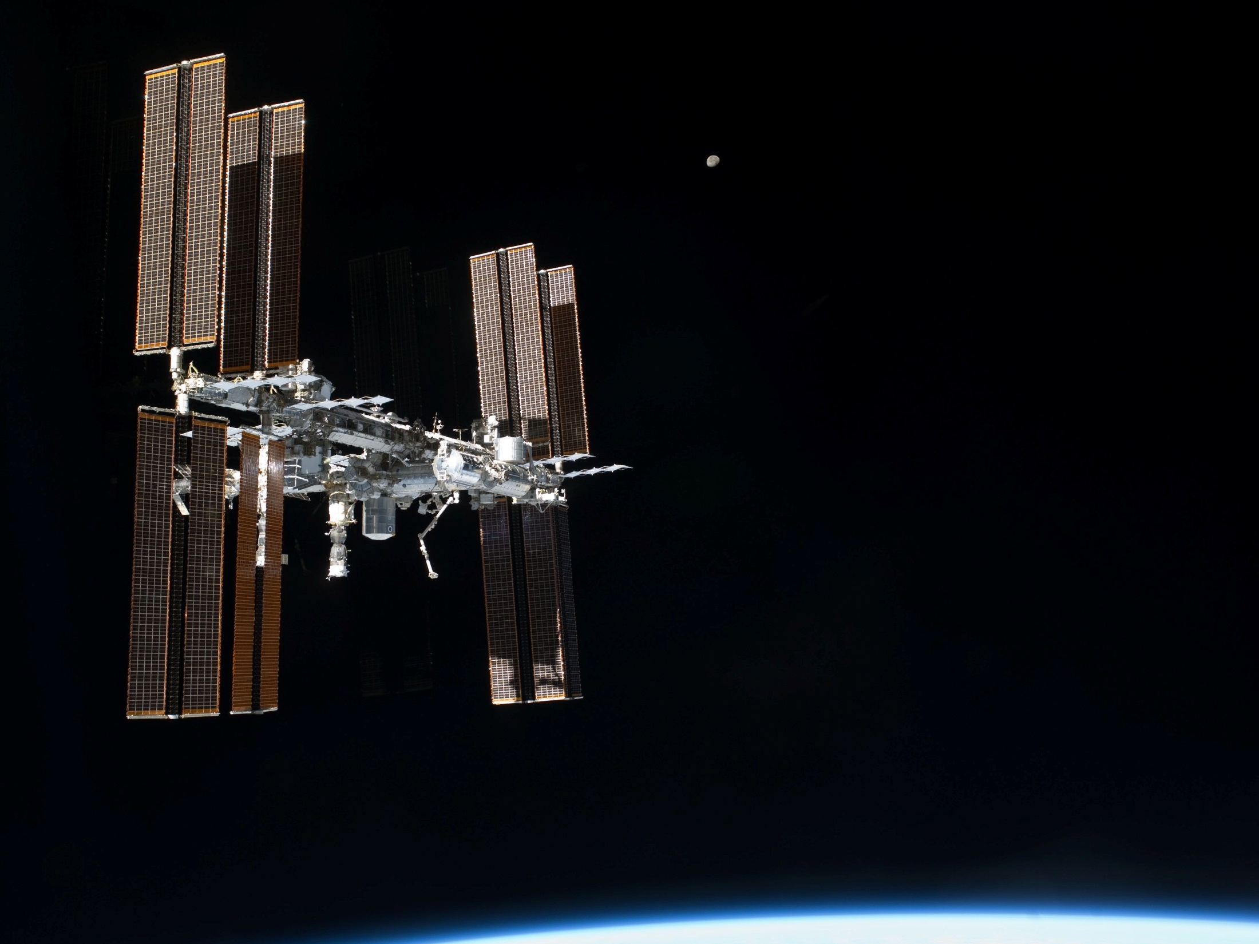

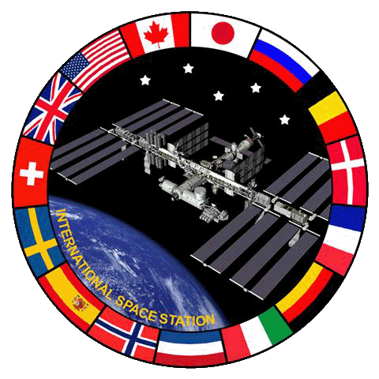
Exploring the Microbiome / Immunome and Disease on the International Space Station
Julie A. Robinson, Ph.D, Chief Scientist, ISS Program &
Associate Director, Human Research Program, NASA
20th Genomic Standards Consortium, San Diego
2 May 2018
Acknowledgments:
Sarah Wallace, Ph.D., Microbiologist, NASA Johnson Space Center
Sylvain Costes, Ph.D., GeneLab Project Manager, NASA Ames Research Center
Notes:
s135e011814 Permalink http://io.jsc.nasa.gov/app/info.cfm?pid=21816380 Title View of ISS as it Rotates 90 Degrees
Description Flyaround view of the forward (FWD) and starboard (STBD) sides of the International Space Station (ISS), taken aboard Atlantis after undocking on STS-135 Flight Day 12 (FD12). In this series of images, the orbiter has paused to photograph the station as it yaws 90 degrees to present its longitudinal axis to Atlantis. An Earth limb and the Moon are also in view.
Caption S135-E-011814 (19 July 2011) --- This picture of the International Space Station was photographed from the space shuttle Atlantis as the orbiting complex and the shuttle performed their relative separation in the early hours of July 19, 2011. Onboard the station were Russian cosmonauts Andrey Borisenko, Expedition 28 commander; Sergei Volkov and Alexander Samokutyaev, both flight engineers; Japan Aerospace Exploration astronaut Satoshi Furukawa, and NASA astronauts Mike Fossum and Ron Garan, all flight engineers. Onboard the shuttle were NASA astronauts Chris Ferguson, STS-135 commander; Doug Hurley, pilot; and Sandy Magnus and Rex Walheim, both mission specialists. Photo credit: NASA

Slide 2

11 years to build….
Notes:
Collier assembly montage

Slide 3
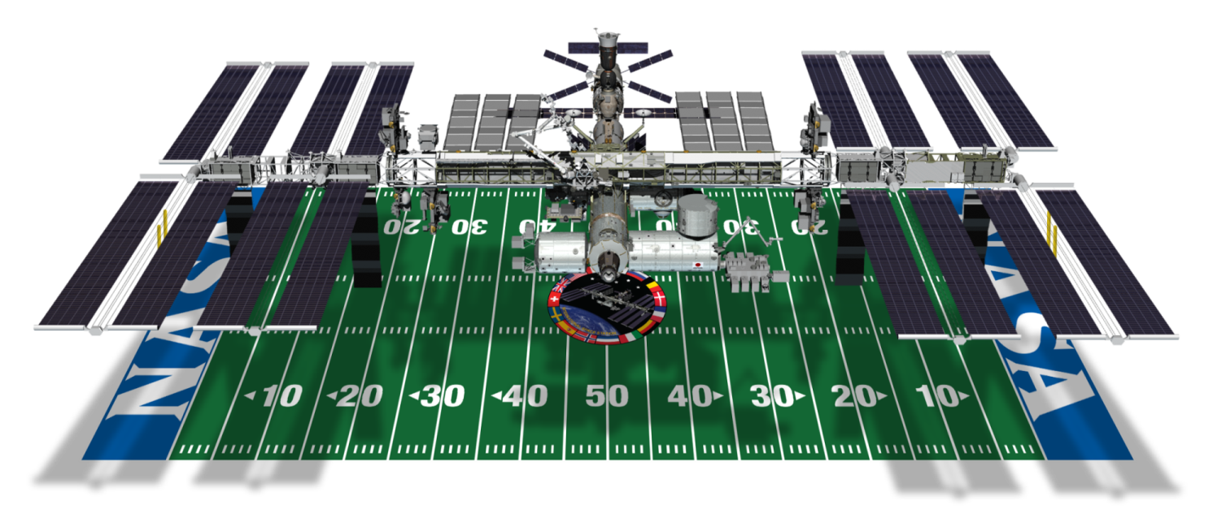
International Space Station
Spacecraft Mass: 799,046 lb (362,441 kg)
Velocity: 17,500 mph (28,200 kph)
Altitude: ~220 miles above Earth
Power: 80 kW continuous
Science Capability: Laboratories built by US, Europe, Japan, and Russia
Extended through at least 2024

Slide 4
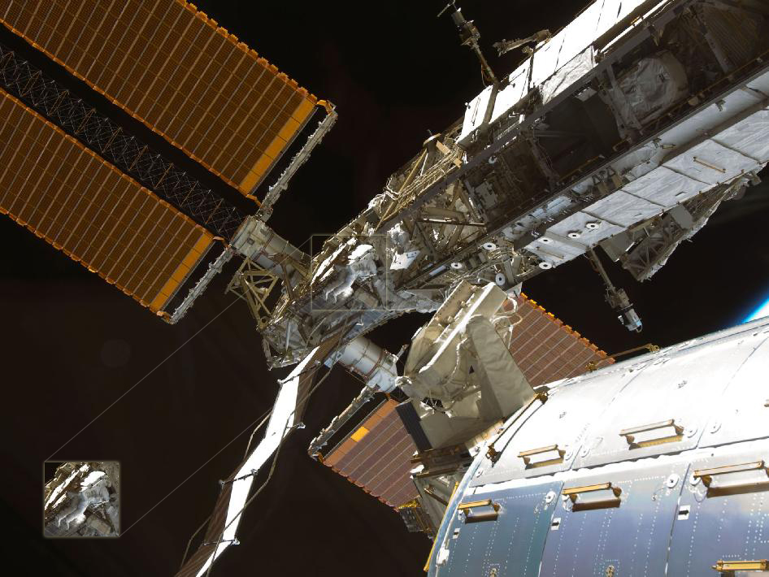
The International Space Station
Background

Slide 5
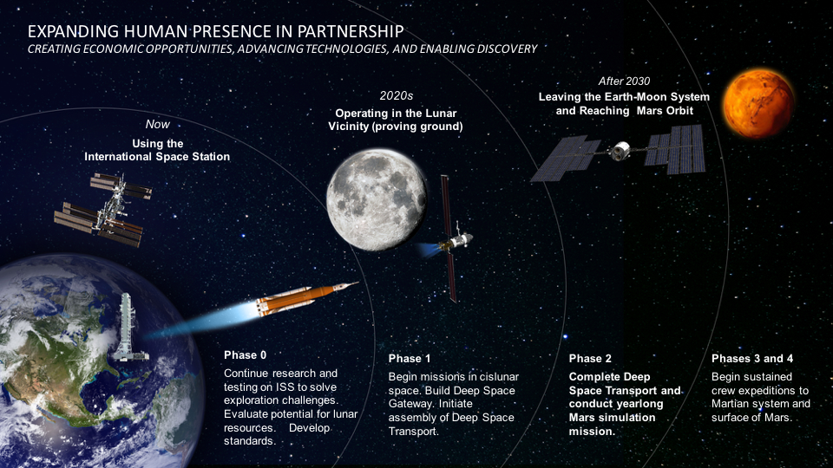

Slide 6







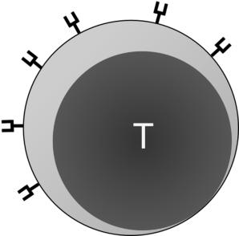

The Microbiome and Omics Studies on the ISS
4
3a
Crew
1
2
3b
Research organisms
and their microbiomes
Human microbiome & Immunome
Built Environment:
Surfaces
Air
Water
Plants for food and
and their microbiomes
Fresh food
5

Slide 7
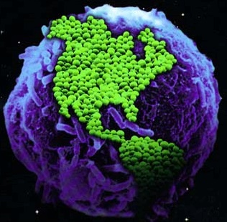
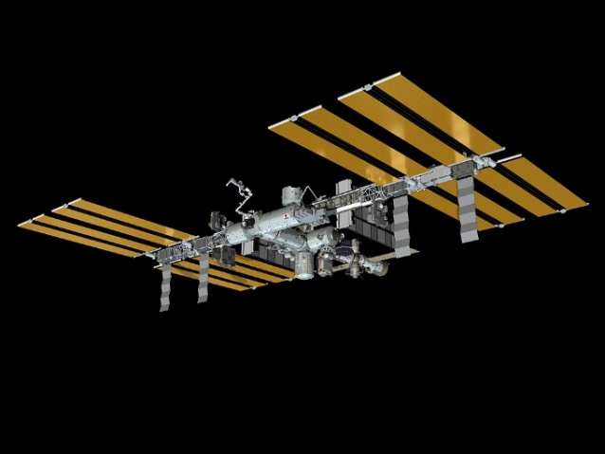

The ISS Microbiome
Goal: Mitigate microbial risk to crew health, safety, and performance
Critical to understand the microbiome of the ISS
Culture-based techniques provide quantitative data per volume/area sampled
Microbial identification is achieved on the ground via biochemical analysis and DNA sequencing
Need to move this to on-orbit for future exploration missions

Slide 8


The ISS Microbiome: Pre-flight Analysis (Modules and Logistics Vehicles - ISS Construction, Expeditions 1-25)
Surface Samples Air Samples
Bacterial Counts
Fungal Counts
Bacterial counts
Fungal counts
956 pre-flight surface samples from modules, Cargo Transfer Bags, and hardware
546/956 (57%) negative for bacteria
53/956 (6%) exceeded pre-flight specifications
954 pre-flight surface samples from modules, Cargo Transfer Bags, and hardware
835/954 (88%) negative for fungi
109/954 (11%) exceeded pre-flight specifications
43 pre-flight samples collected in modules
17/43 (40%) negative for bacteria
No sample exceeded pre-flight specifications
44 pre-flight samples collected
29/44 (66%) negative for fungi
1/44 (2%) exceeded pre-flight specifications

Slide 9
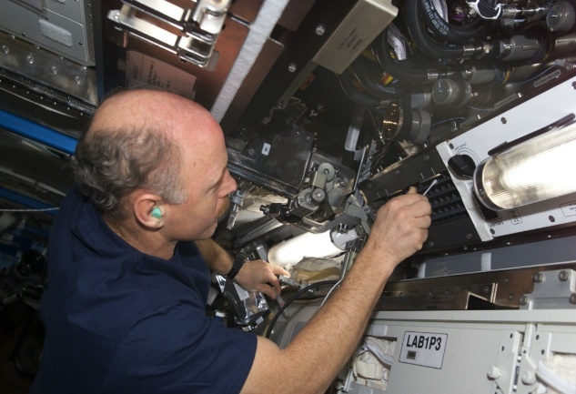
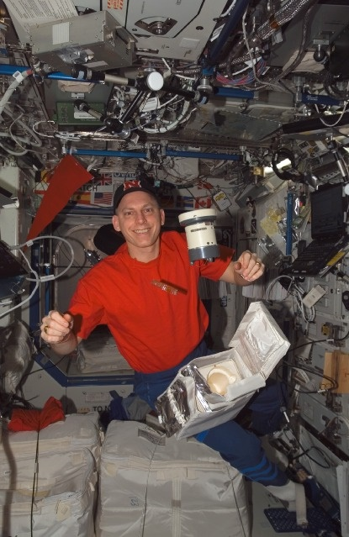
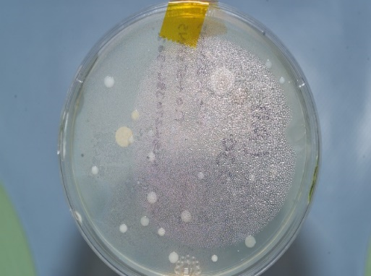
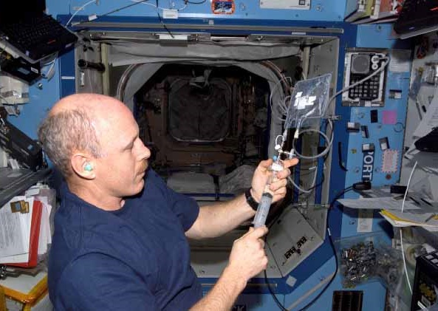
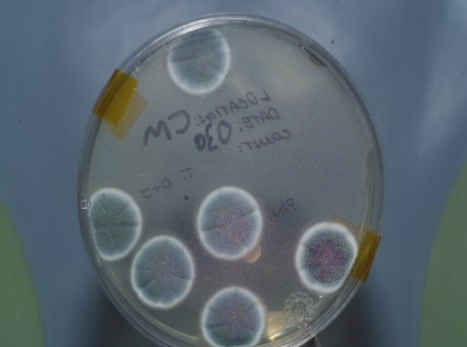
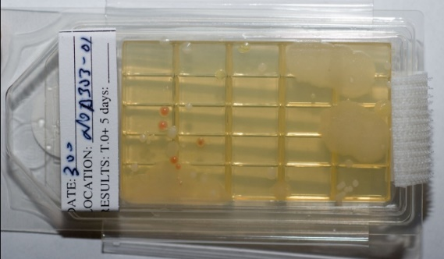
The ISS Microbiome: In-flight Sampling
Quantified on the ISS and Returned to the JSC Microbiology Lab for Identification

Slide 10
The ISS Microbiome: In-flight Analysis
In-flight Surface Microbe Levels
In-flight Air Microbe Levels
Bacterial counts
Fungal counts
Bacterial counts
Fungal counts
16% negative for bacteria
3% exceeded in-flight specifications
63% negative for fungi
4% exceeded in-flight specifications
32% negative for bacteria
No sample exceeded in-flight specifications
72% negative for fungi
5% exceeded in-flight specifications

Slide 11
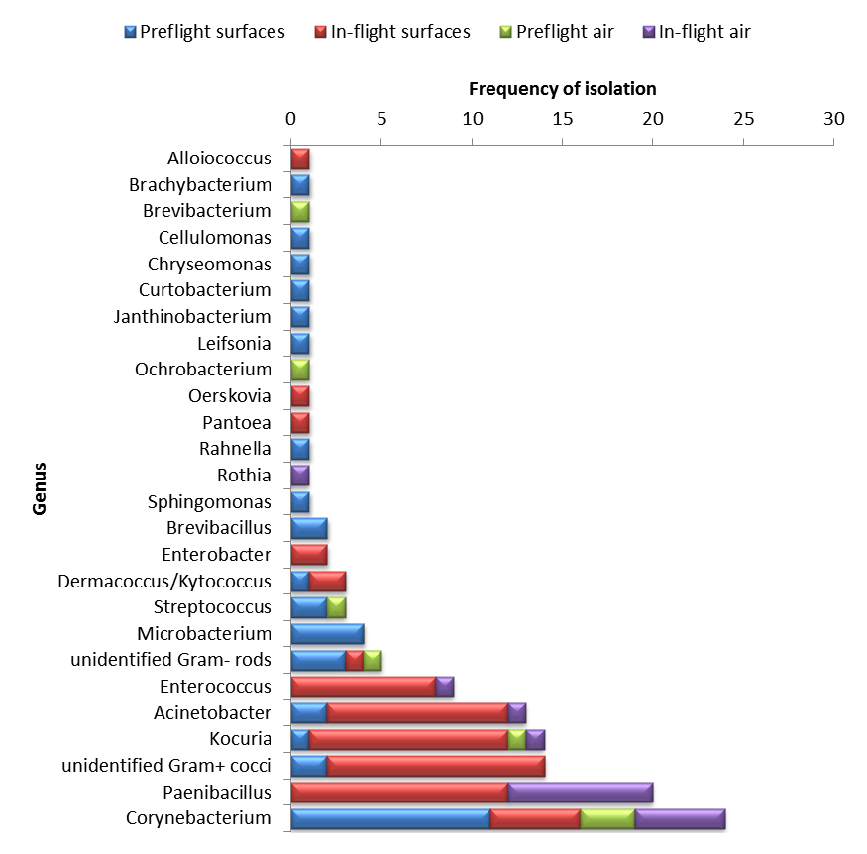
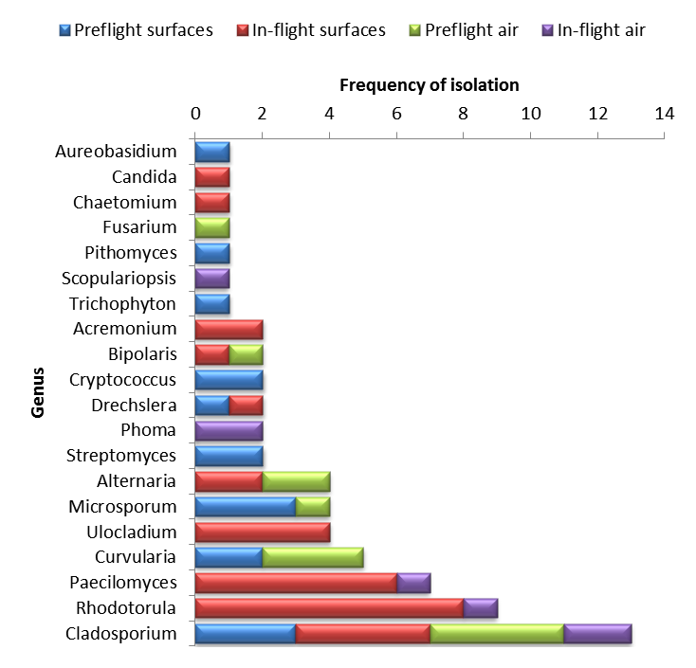
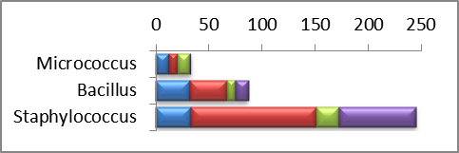
The ISS Microbiome: Pre-flight and In-flight Surface and Air Genera
Bacteria Fungus

Slide 12
The ISS Microbiome
On average, microbial levels on station are lower than homes assessed with comparable methods
The majority of the microorganisms are common human- and environmental-associated organisms
On occasion, opportunistic pathogens have been isolated. Finding these types of medically-significant organisms triggers remediation
Differences exist between the US and Russian segments
Small changes noted with new crew/cargo
Largest changes in the microbiome of individual segments is noted when new activities are introduced
Hygiene
Exercise
Movement of the galley
Research investigations with molecular technologies are ongoing to enhance our understanding of the ISS microbiome

Slide 13

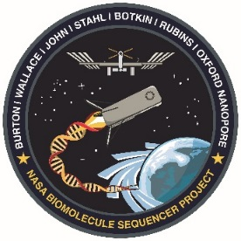

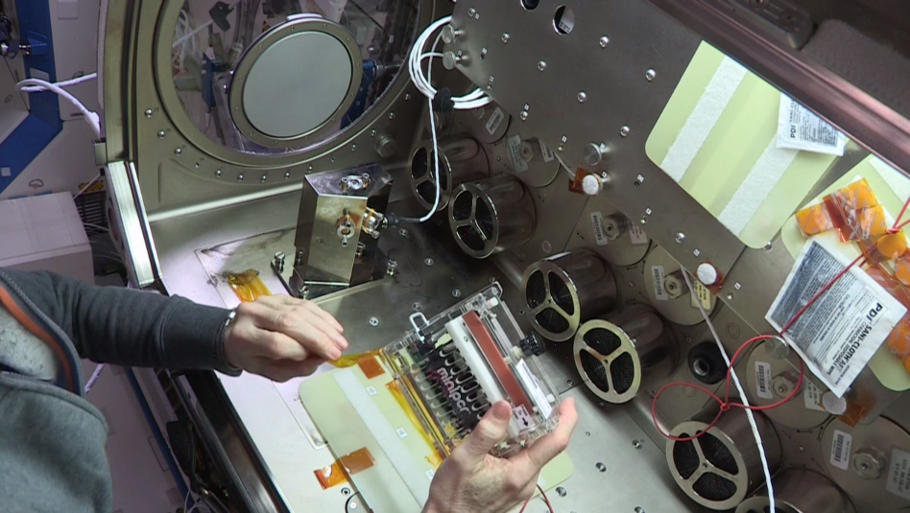
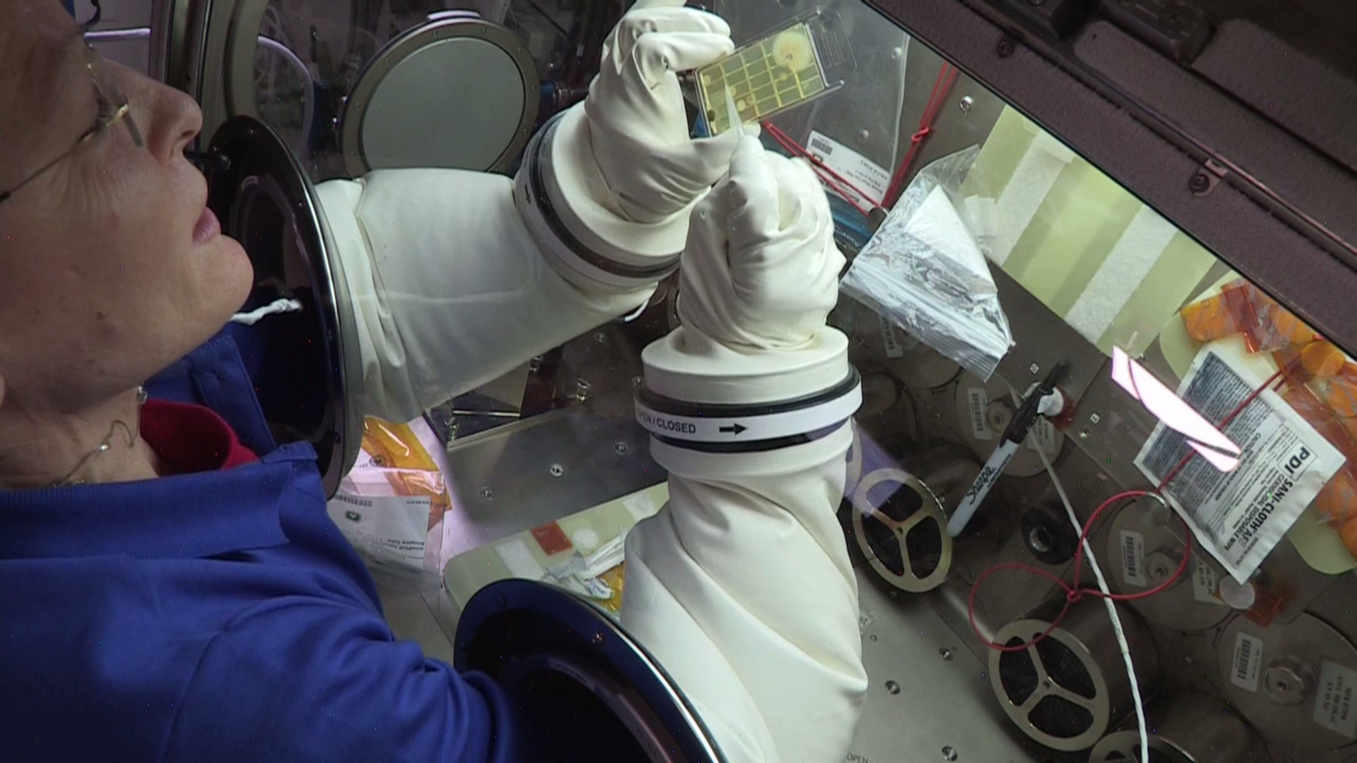
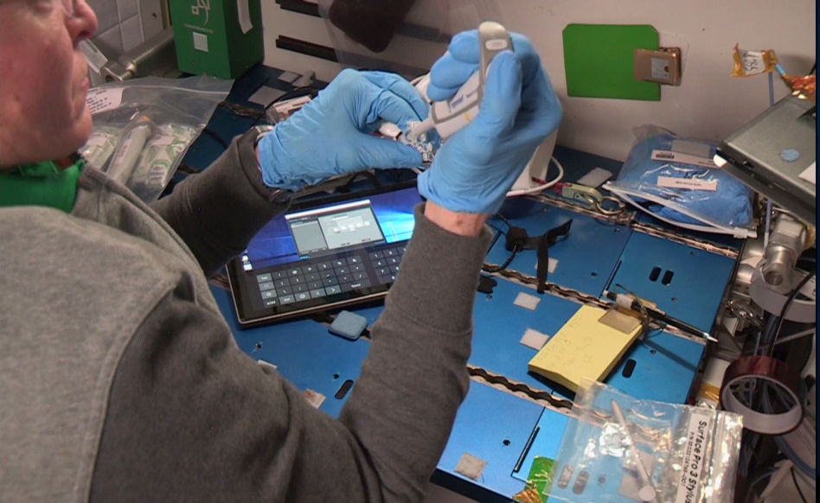
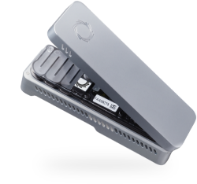
The ISS Microbiome: Molecular Technology on Station
The Genes in Space-3 Investigation
miniPCR
MinION
(aka Biomolecule Sequencer)
Astronaut Peggy Whitson collecting microbial cells from an Environmental Health Systems (EHS) Surface Sample Kit (SSK) Slide.
Data downlinked from station

Slide 14
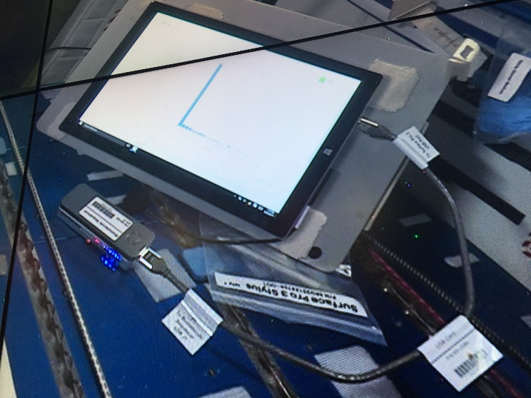
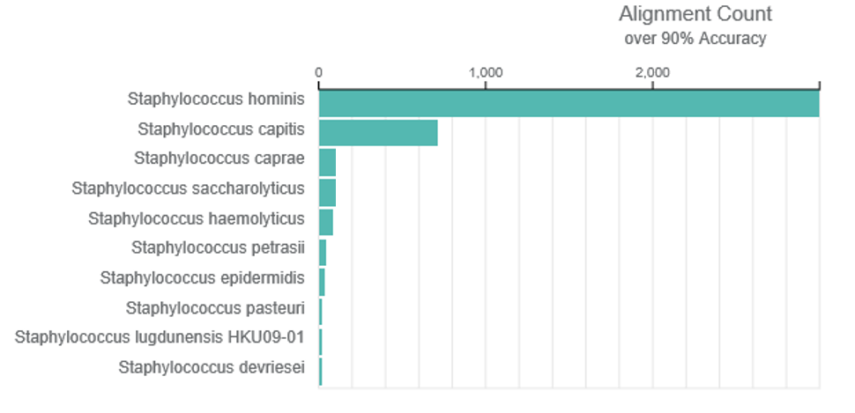
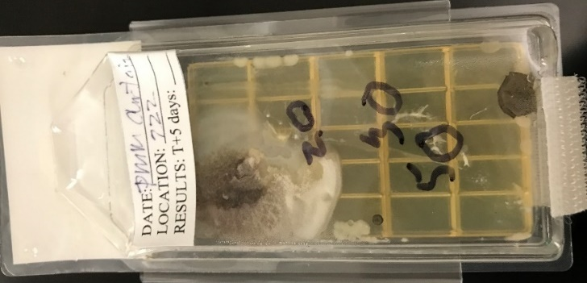
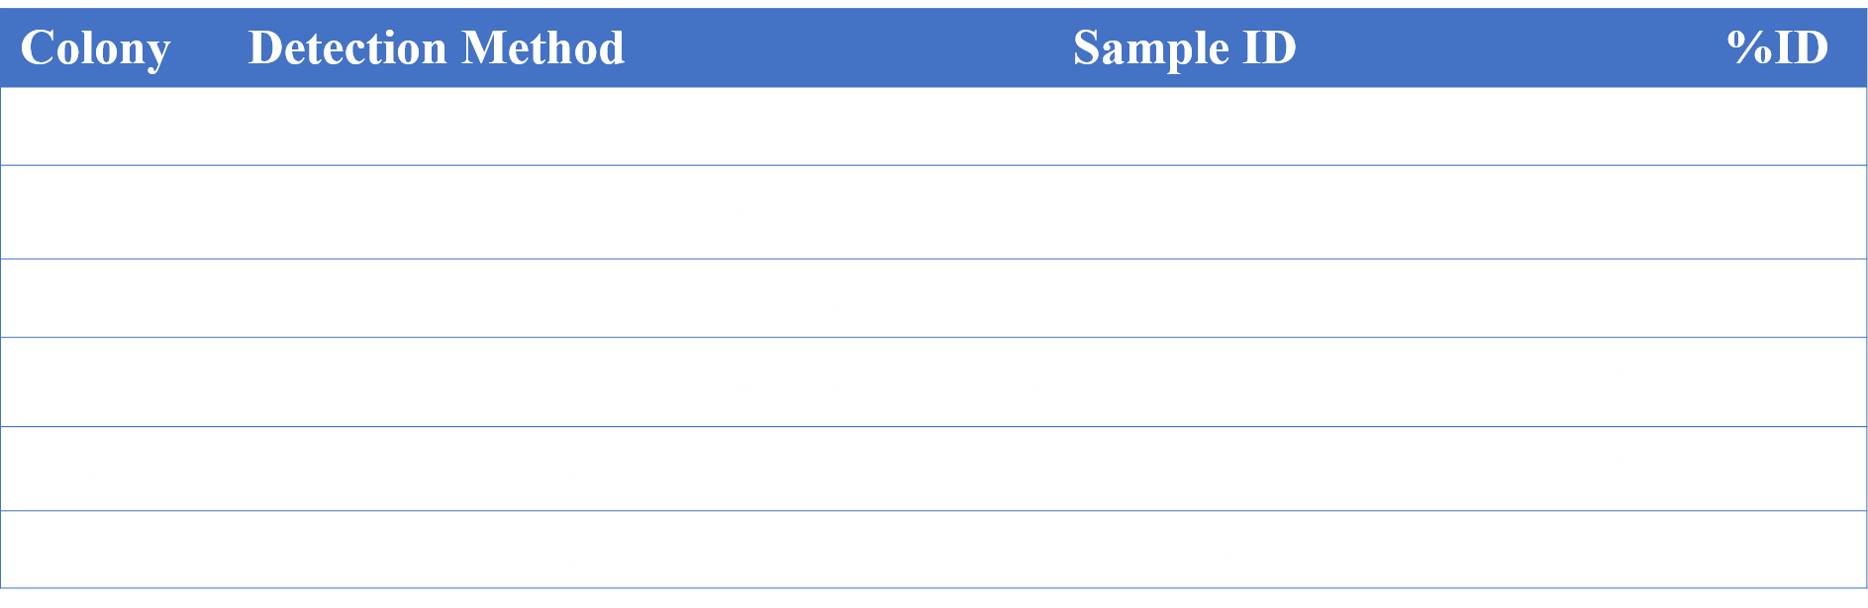
The ISS Microbiome: Molecular Technology on Station (Genes in Space-3)
Data obtained in-flight is downlinked to the ground for analysis:
agtcgatcgatagctagagcatcgatcgagggaggtaccgattagggtattaccccgatagggtaagatagcagggacatttacggattacggagacttcgatacgatactgtgaccagt
Return sample processed through normal procedures in the Microbiology Lab:
Success! The sequence data from the ISS matches the identifications obtained on the ground! This represents the first ever identification of unknowns in space.

Slide 15

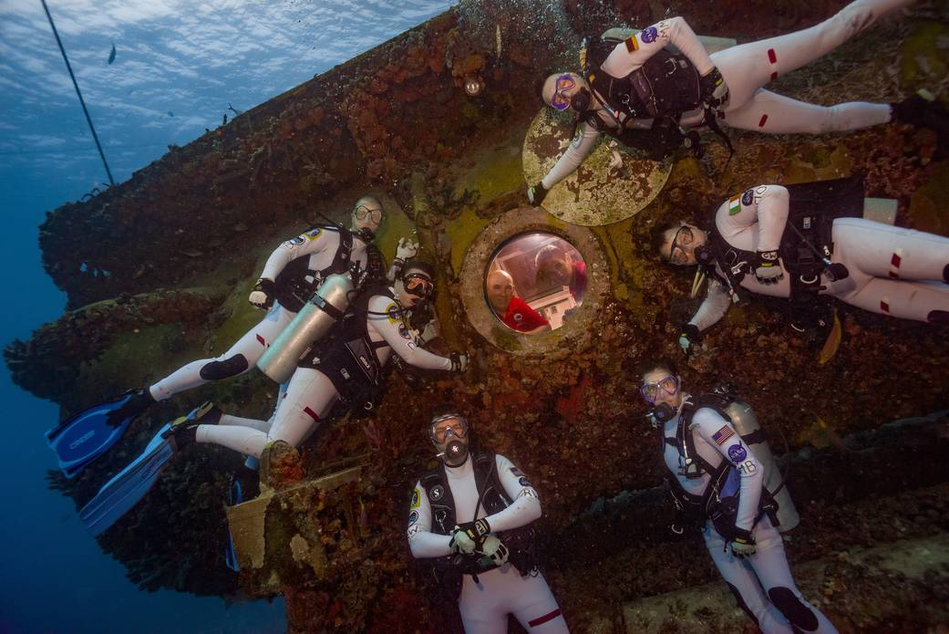
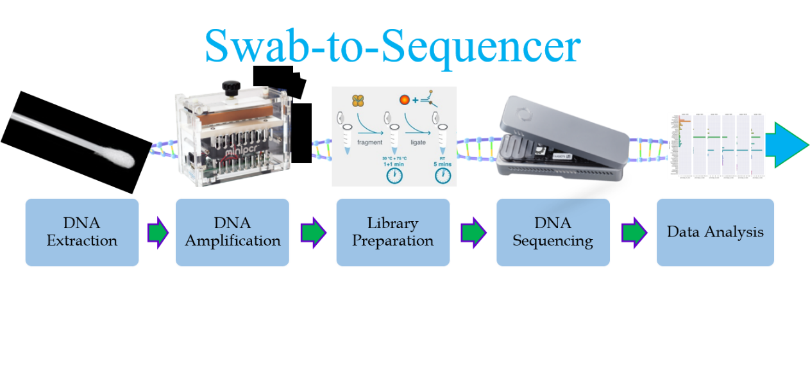
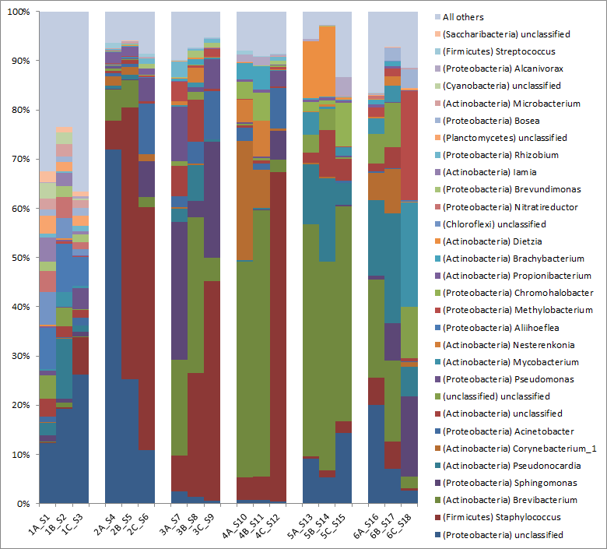
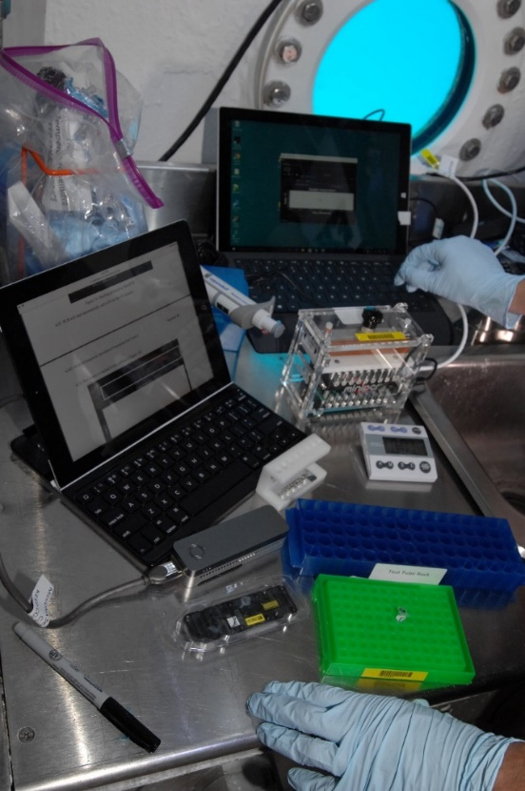
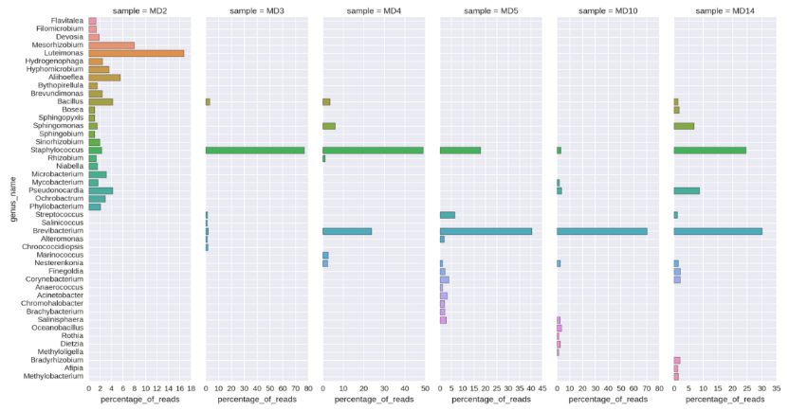
The Aquarius Microbiome: Molecular Technology on the Ocean Floor
Culture-independent analysis: NEEMO 21 & 22
Illumina MiSeq
miniPCR
The validated, culture-independent, swab-to-sequencer process will be transitioned to the ISS as part of the Biomolecule Extraction and Sequencing Technology (BEST) payload launching on Orbital ATK CRS-9 (May, 2018)!
Oxford Nanopore Technologies MinION
MinION
(aka Biomolecule Sequencer)

Slide 16
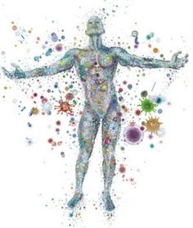
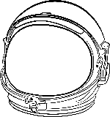
The Astronaut Microbiome
Evaluation of changes in the crew microbiome during spaceflight missions
PI: Hernan Lorenzi, Ph.D., J. Craig Venter Institute
Samples are collected pre-flight, in-flight, and post-flight from 9 astronauts
Samples include two skin sites, nostrils, fecal, and potable water, as well as blood and saliva for immunological evaluations
Crew diets and medications are being included in the analyses
Tightly monitored metadata (e.g., temperature, humidity) is available
Publication anticipated soon

Slide 17
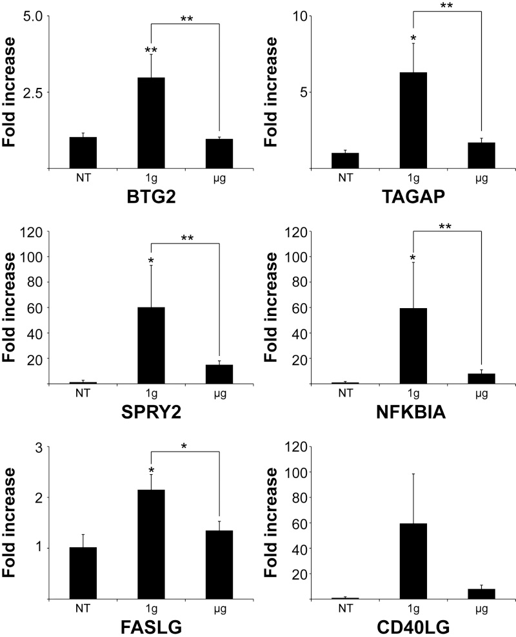
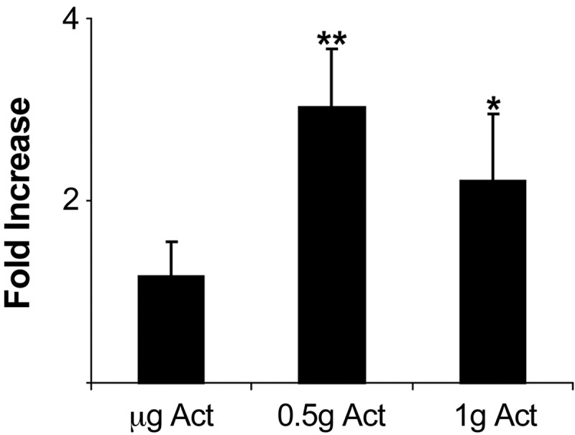
Evidence of effects of microgravity on T-cell activation in vitro on ISS
Real-time confirmation of miR-21 down-regulation of gene expression in CD4+ T cells flown on ISS.
qRT-PCR of genes selected from gene array analysis in nonactivated and concanavalin A/anti-CD28 activated human indicating altered gene expression in ISS spaceflight vs. normal gravity onboard controls (1.5 h).
Hughes-Fulford M, Chang TT, Martinez EM, Li C-F. Spaceflight alters expression of microRNA during T-cell activation. The FASEB Journal. 2015;29(12):4893-4900. doi:10.1096/fj.15-277392.

Slide 18
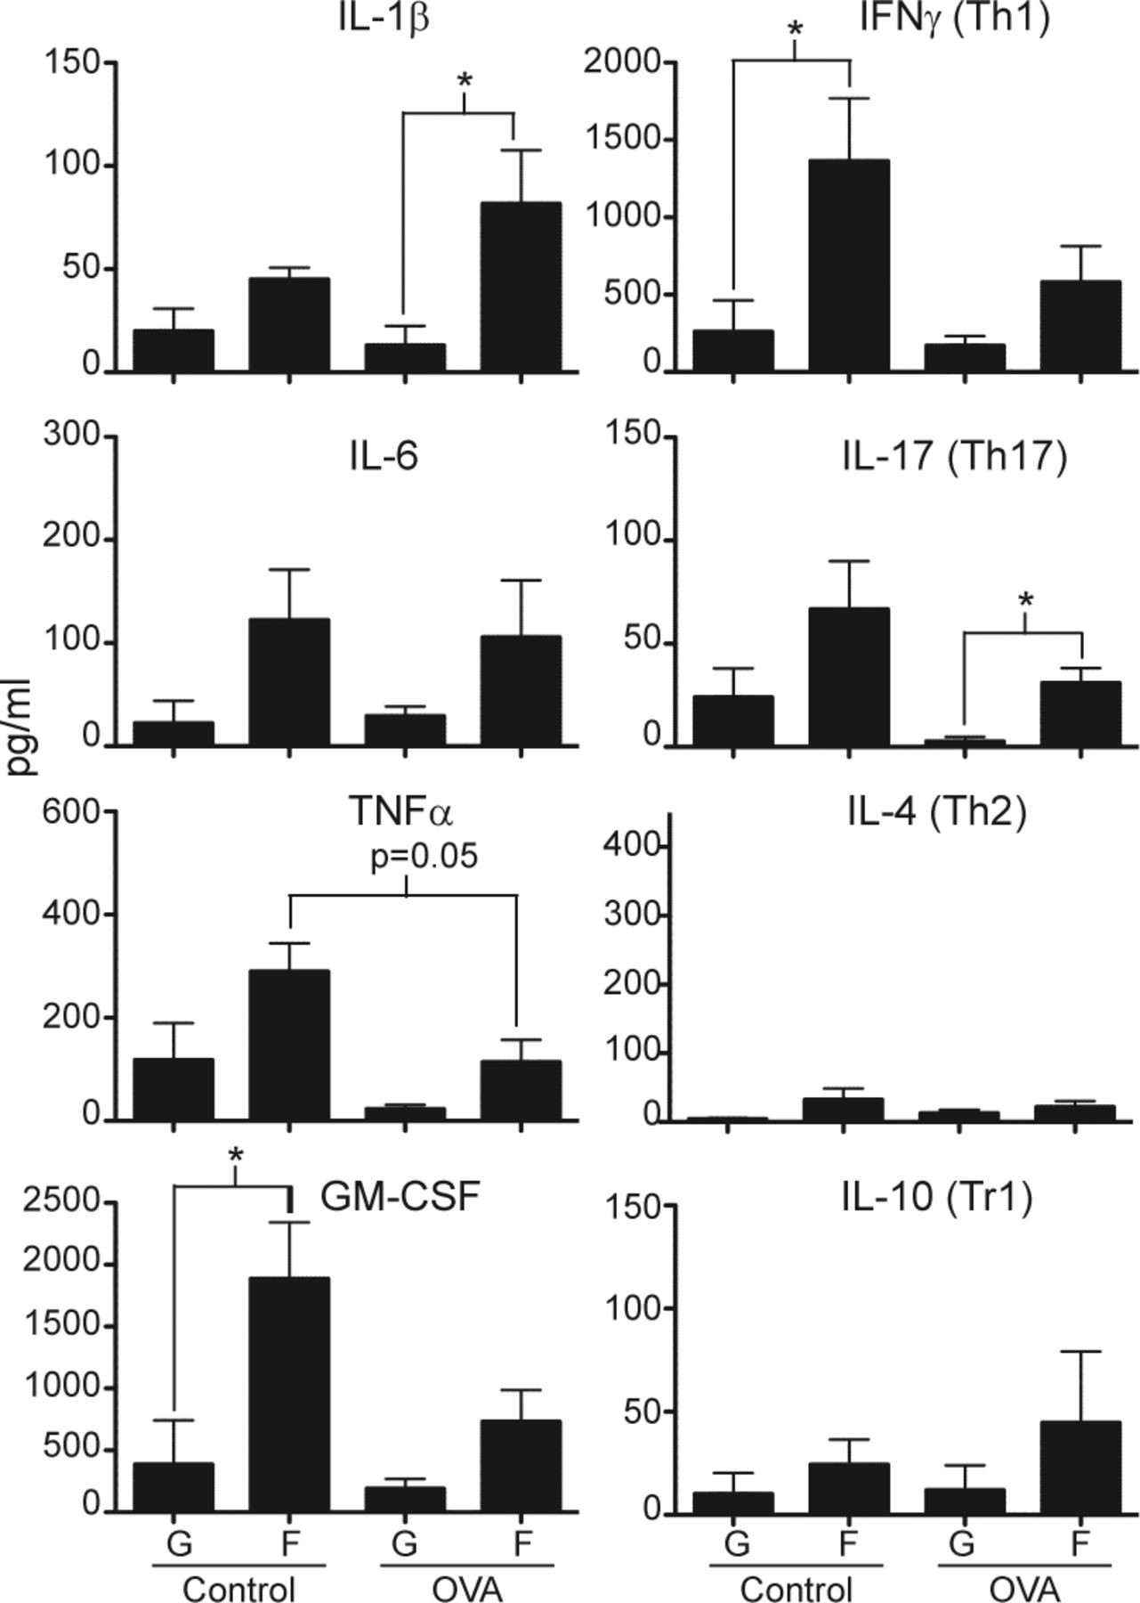
In vivo antigen-specific CD4 T-cell response in mice induced during spaceflight showed
disrupted induction of T-cell tolerance
impaired maintenance of memory T-cell homeostasis
led to the development of a heightened inflammatory response.
Cultures from flight mice produced increased proinflammatory cytokines to OVA peptide restimulation compared with ground mice
Published in: Tammy T. Chang; Sandra M. Spurlock; Tara Lynne T. Candelario; S. Marlene Grenon; Millie Hughes-Fulford; The FASEB Journal 2015, 29, 4122-4132. DOI: 10.1096/fj.15-275073

Slide 19
Evidence of functional insufficiency of the human immune system in producing cytokines in space—
even though leukocyte, lymphocyte and T-cell counts are unchanged.
(And crewmembers don’t get sick.)
Secreted Cytokine Profiles: Mean ISS Data (n=23), 48hr Culture – PMA/I Stimulation
Crucian BE, Stowe RP, Mehta SK, Quiriarte HD, Pierson DL, Sams CF. Alterations in adaptive immunity persist during long-duration spaceflight. npj Microgravity. 2015 September 3; 1: 15013. DOI: 10.1038/npjmgrav.2015.13.

Slide 20
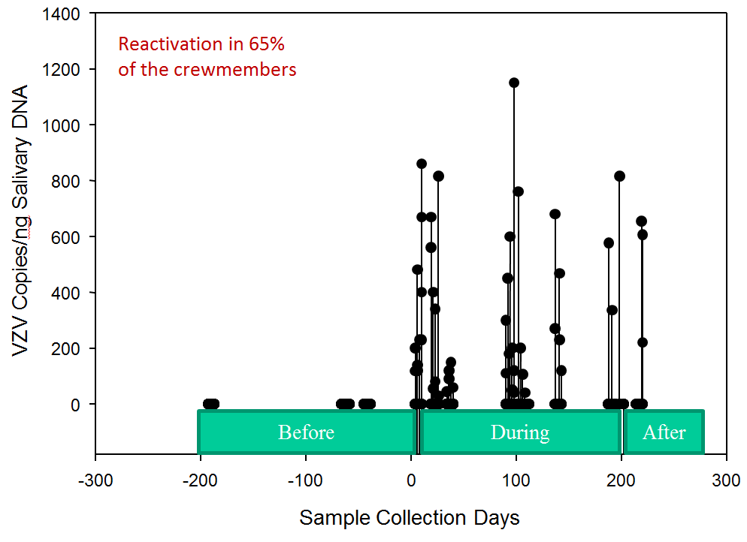
VZV Reactivation in ISS Crewmembers
B. Crucian

Slide 21
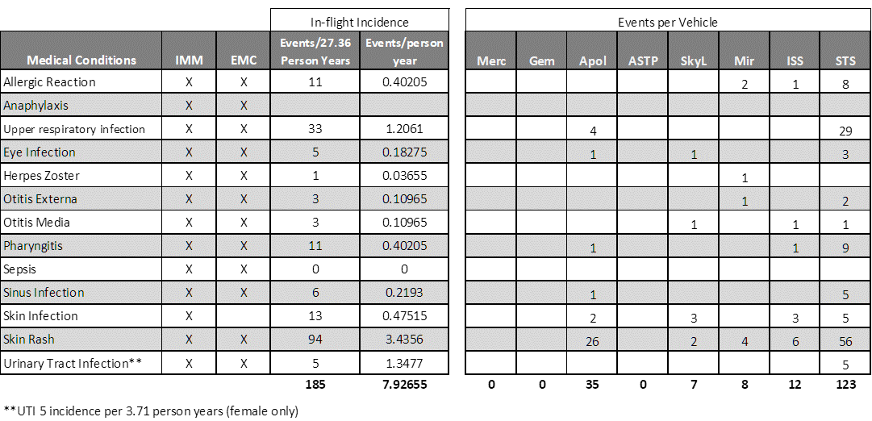
Existing Incidence Data
Cumulative flight incidence data summary (all vehicles) from Clinical Finding Forms
Integrated Medical Model (IMM) group created the CLiFF format
Integrated Medical Evidence Database – Forms by Condition (83)
Provides a structured format that houses medical inputs for the model along with the supporting information

Slide 22
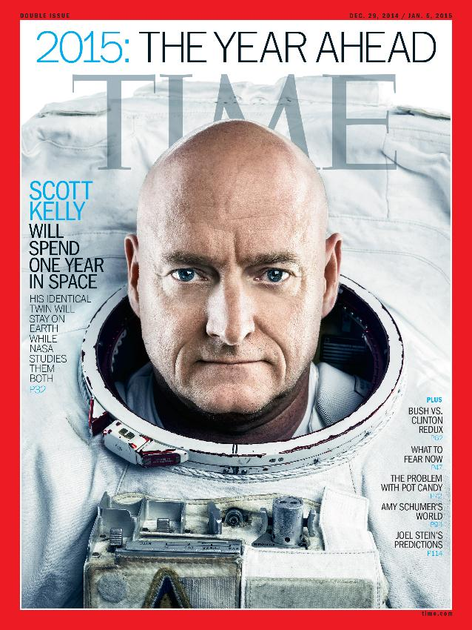

Slide 23
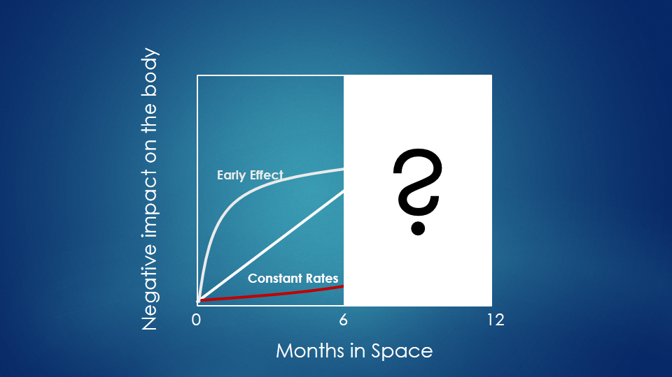

Slide 24
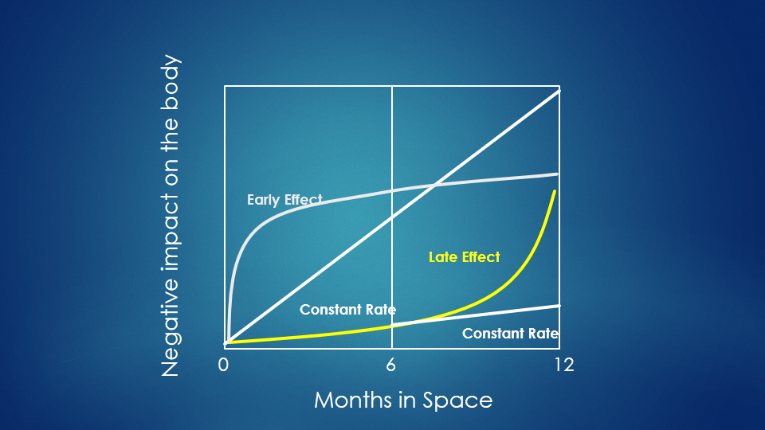

Slide 25
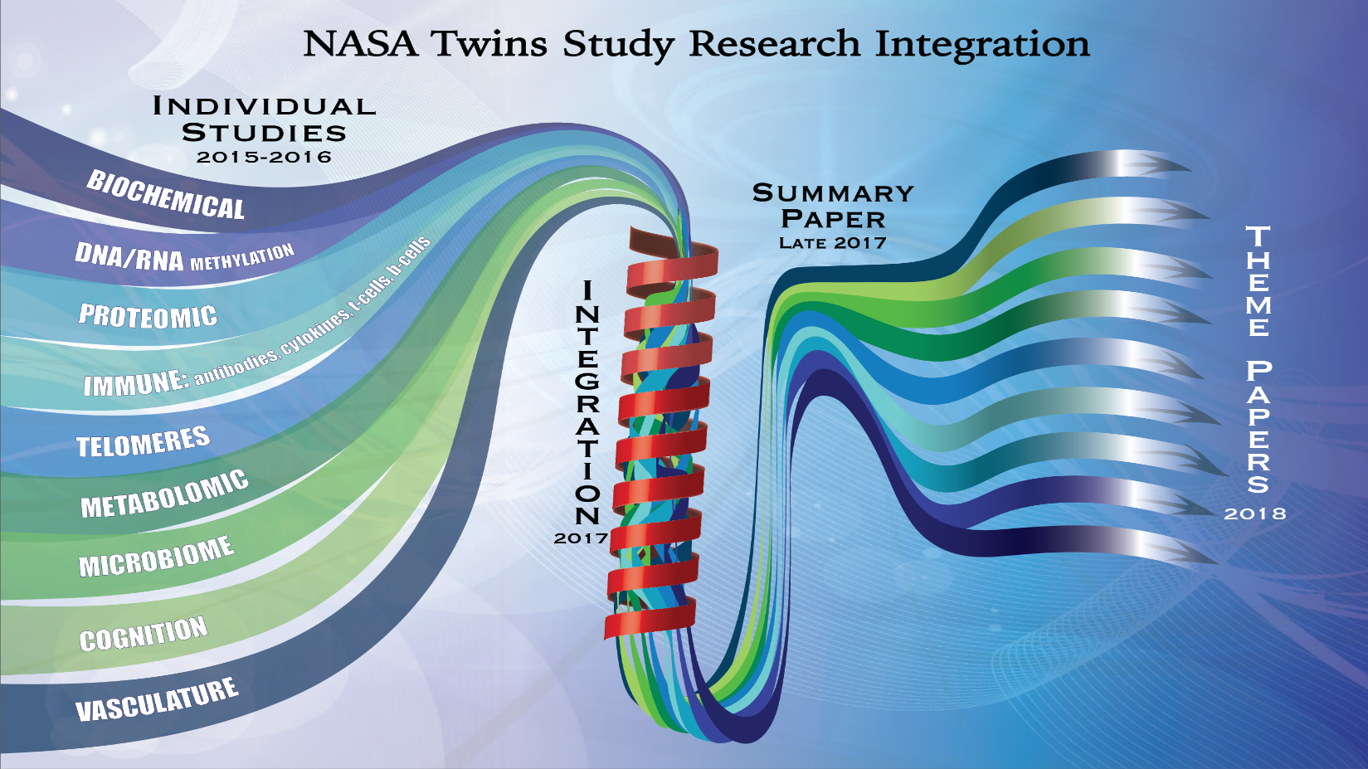
8
- 2019

Slide 26
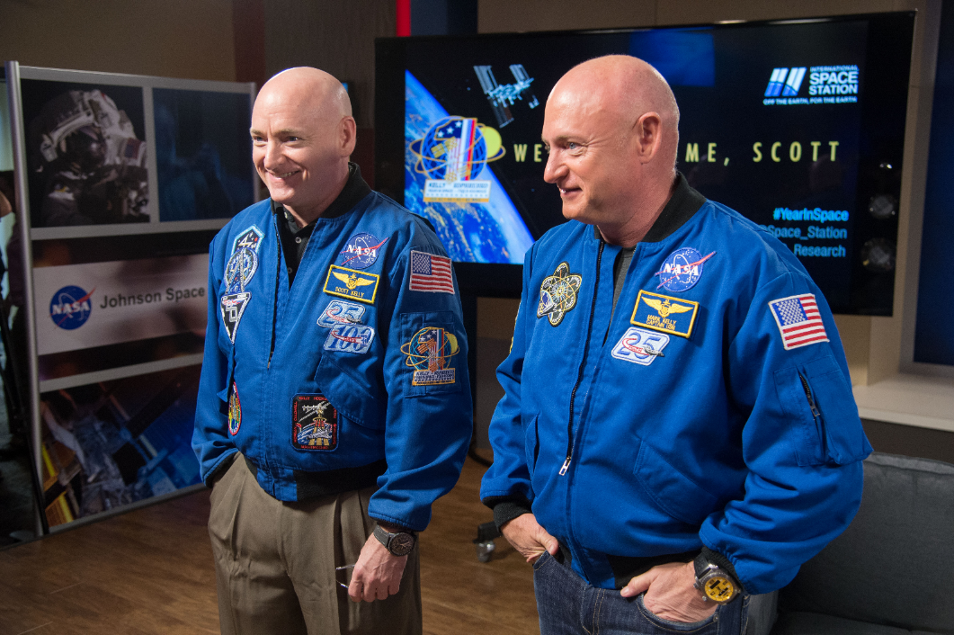
Unpublished but Publicly Discussed Twin Study Results
Telomere Length (Susan Bailey, Colorado State University)
Astronauts have shorter telomeres than healthy age/sex-matched controls pre-flight
In flight: telomere length consistently increased for all astronauts
Post-flight: telomere length returns to baseline levels within TWO DAYS
Gene Expression (Chris Mason, Weill Cornell Medicine)
93% of gene expression returned to normal after landing
Possible longer term changes in genes related to immune system, DNA repair, bone formation networks, hypoxia, and hypercapnia.
Inflammation (Mike Snyder, Stanford)
Spike in a group of cytokines just after his return to Earth that remained elevated for six months.
A set of cytokines that were elevated before flight and remained elevated throughout the mission.
Elevated proteins associated with insulin activity and blood sugar response
Immune Response to Flu Vaccine (Emmanuel Mignot, Stanford University)
flu vaccine given aboard the space station produces the expected immune stimulating effects inflight as well as on the ground
*** (p= 0.0003)
**** (p= <0.0001)
* (p=0.028)
Telomere Length: qPCR

Slide 27
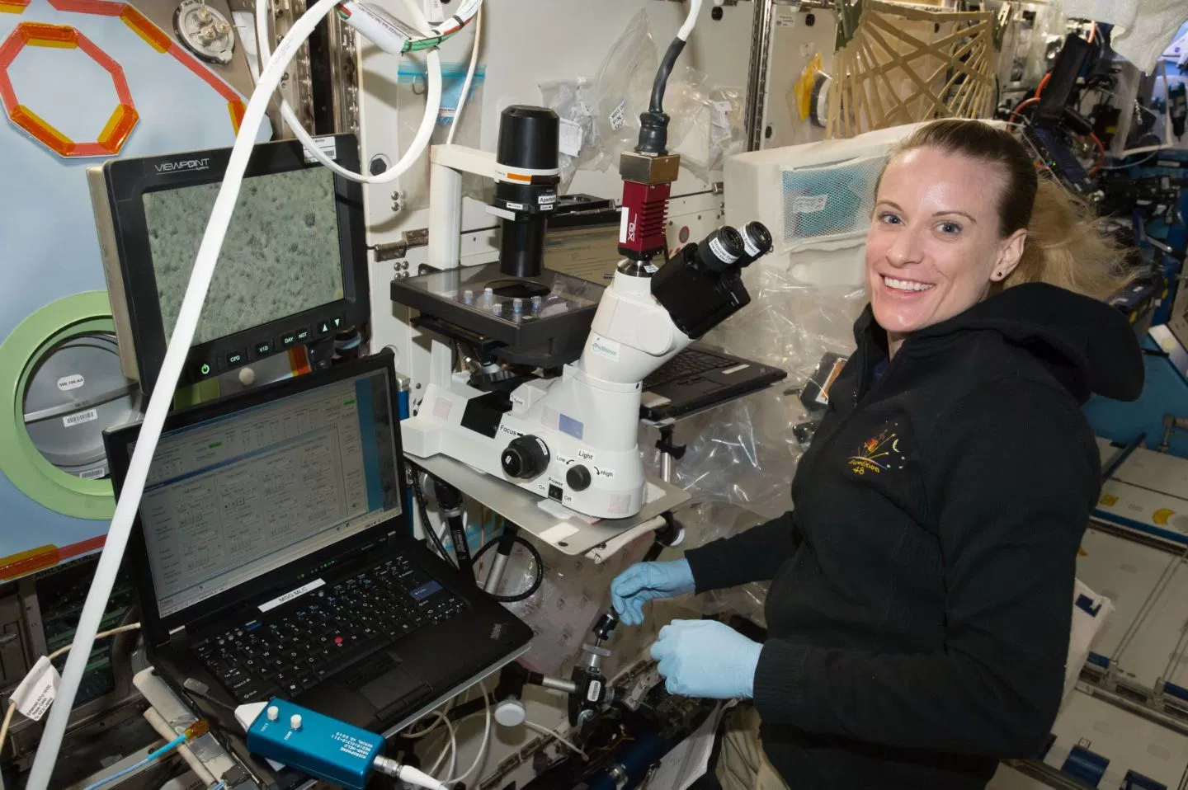


Slide 28
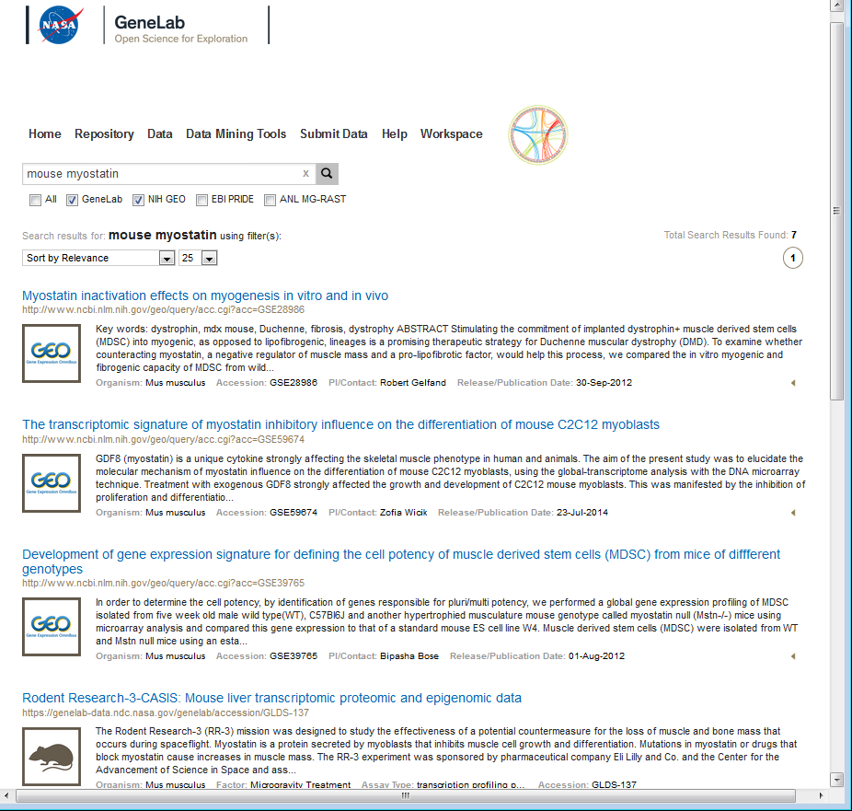
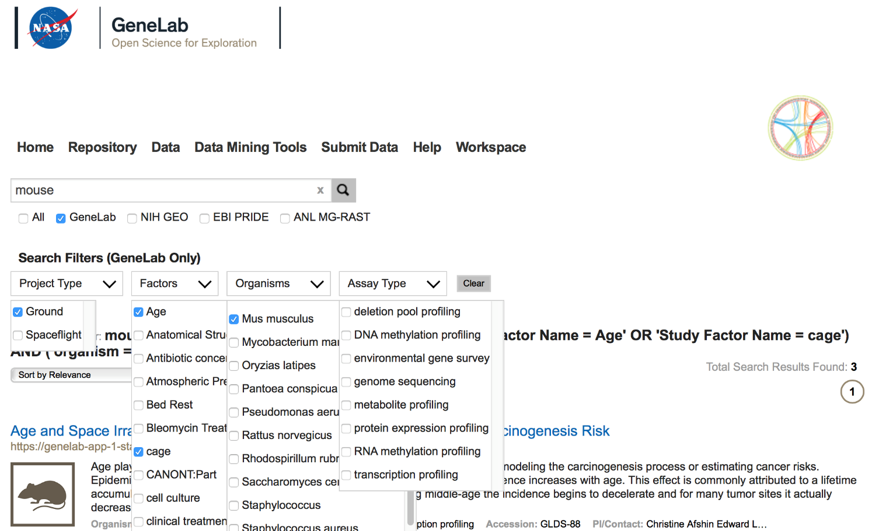
GeneLab Data System Phase 2 (Release 2.0 – October 1st 2017) Google-like Search, Federated Search
Data federation/integration with heterogeneous bioinformatics external databases (GEO, PRIDE, MG-RAST)
Federated Search
Search Filters for GeneLab

Slide 29
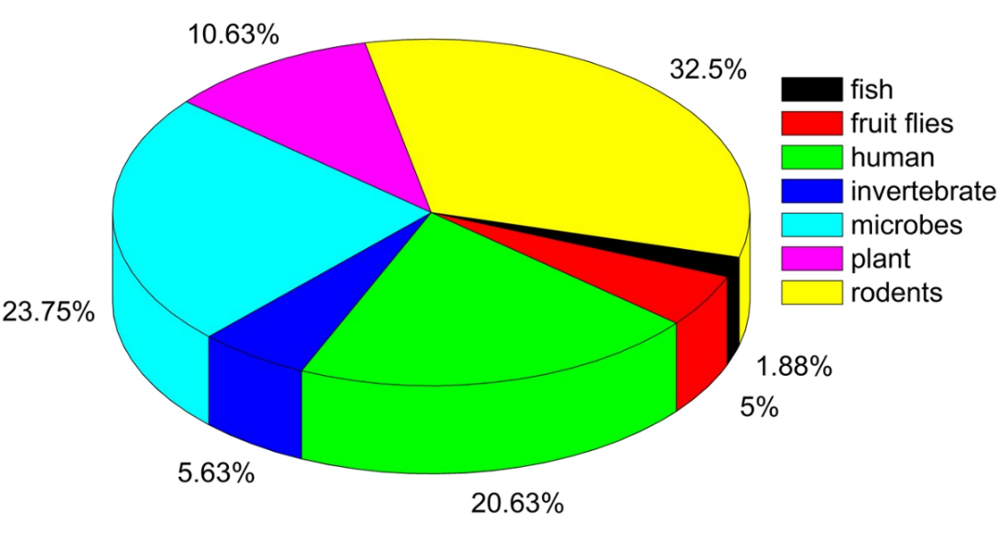
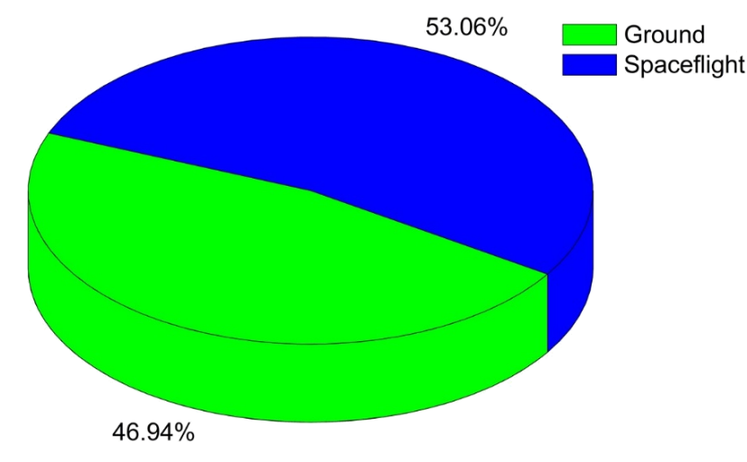
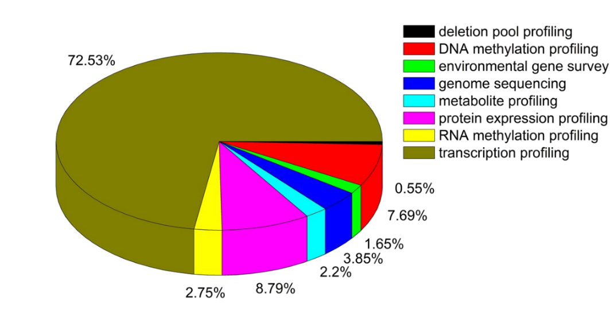
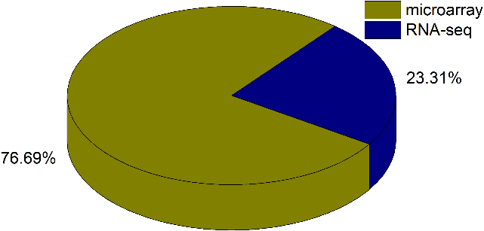
GeneLab Database: 154 data sets, April2018
Data Growth Since 2014
Distribution by organism type
Majority is spaceflight samples
Distribution by assay type
Notes:
This slides shows the general status of GL since its creation in 2014. One can see the number of dataset is growing faster every year. Also, the size of each dataset has gone up and reached a plateau mainly reflecting the switch from microarray gene expression data to much deeper set of RNAseq dataset. Pie chart shows the variety of of sample by organism, going from microbes and plants all the way to rodent and human cells. Half of the data are ground data and the majority of the data is transcriptomics (primarily microarray from legagy data and more recently from RNA-seq from ISS experiments).

Slide 30

Future analysis capabilities
Cohort comparison
Display the expression of a gene query or its frequency of differential regulation based on sex, species, tissue, or age
Example: From a systems biology analysis, TGFβ1 was found to be a master regulator impacting spaceflight
Notes:
GL will eventually have a visualization portal allowing users to query simple questions relevant to space biology. We are now covering some of the type of information we hope to make easier to access for investigators. In this first example, the idea is the ability to query one gene status across many different dataset. Here, for example, TGFbeta-1is shown to be down-regulated across 7 different rodent dataset, measured from STS and ISS missions.

Slide 31

Future analysis capabilities
Relevance to human disease
Display the expression of a query gene or its frequency of differential regulation in disease types
Example: Using the GeneLab data we are able to make predictions on impact on health and risk of diseases due to space flight
Notes:
In this next future ability, one will also be able to see if any molecular changes found in our data are linked to a specific disease. In this example agains across 7 different rodent dataset, and within many different type of tissues, we see that many disease signatures are being detected: e.g. liver tumor, hear disease, Red Blood Cells issue

Slide 32

Future analysis capabilities
Tissue expression
Display the expression of a query gene based on cell or tissue type
Example: Can make direct comparisons from of key genes to data from the literature.
Notes:
One could also focus on expression from one single tissue type. In this example, it is interesting to compare gene expression from one single study in bone (Blabler data in red) with a meta-analysis of average gene expression across various studies and tissue (black bars). Genes are color-labeled with respect of their functions.

Slide 33

First GeneLab Meta Analysis publication: Global transcriptomic analysis suggests carbon dioxide as an environmental stressor in spaceflight
Used genelab to test a new hypothesis using data from 5 previous spaceflight rodent studies
Could atmospheric CO₂ be a more important factor in what have been interpreted as physiological responses to microgravity?
Rodent cage types (producing carbon dioxide differences) could be influencing metabolism, immune response, and potentially the activation of cancer related pathways even without microgravity and space radiation
Support a growing focus on the interaction between microgravity and atmospheric CO₂ producing physiological effects in space
“Global transcriptomic analysis suggests carbon dioxide as an environmental stressor in spaceflight: A systems biology GeneLab case study”, Scientific Reports, March 2018, DOI: 10.1038/s41598-018-22613-1

Slide 34



ISS Research & Technology
http://www.nasa.gov/iss-science
CASIS ISS National Laboratory
http://iss-casis.org
NASA GeneLab
http://genelab.nasa.gov
@ISS_Research

